Slide 1

1. Change the position of “Support” in to other position, it confuses with Search symbol. And darken the search symbol.
2. Change the color of the symbol and font of the website name.
3. Reduce the height of search bar to search bar height (Red color to Yellow color). And Search and Support at the center of menu bar height.

Slide 2
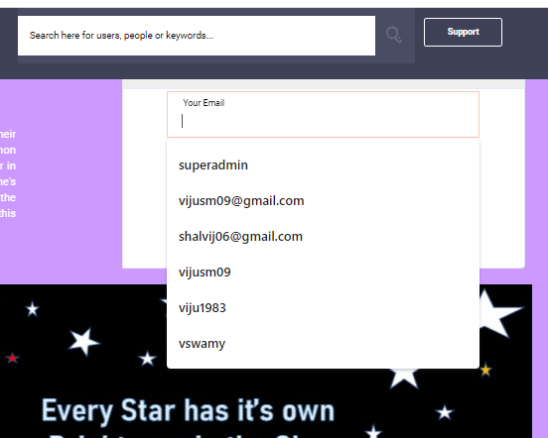
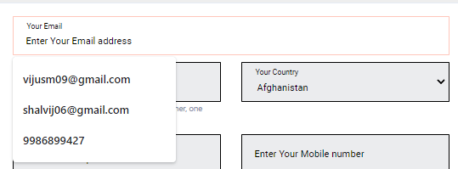
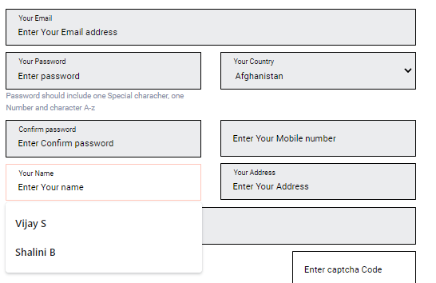
Removal of old or other registration data during NEW sign-in and registration. Exam: Name, mail ids, etc….

Slide 3

It is observed the OTP from message is coming around 30 seconds to 1 minute.
Verification link is coming to mail box around 10 to 15 minutes.
Opinion : Due to more delay due to traffic, user may lose interest or forget to registration.
Solution : We can mention the minutes range to user initial itself.

Slide 4
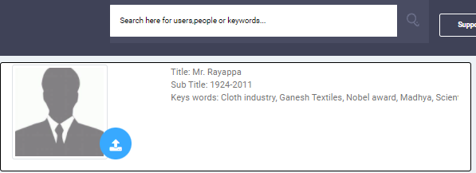
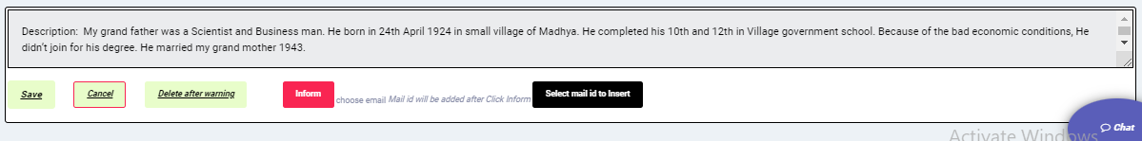
Title : Remove the Mr. Rayapp….. Instead…. Title of your profile.
Sub-Title : Remove year--- Instead ----- Write your sub title
Key words: example --- Instead---- About your Talents and Success
Solution: Our real profiles will give some idea of to write title and sub title.
Remove the example paragraph---- Instead--- Write about success and talents

Slide 5

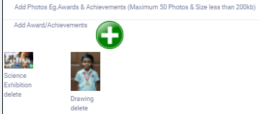
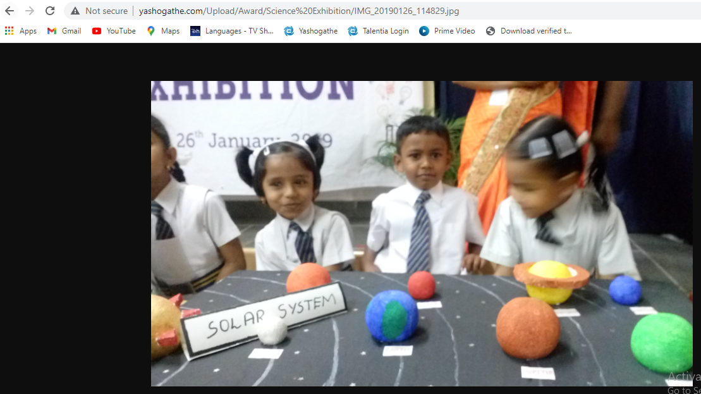
Need a small sentence about what is Public and Private
Back Icon on image (optional)
Back Icon on image (optional)

Slide 6
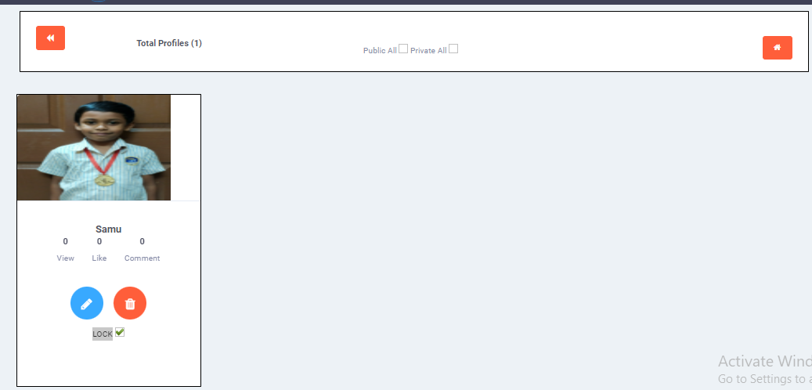
Image should be center of the profile.
How to unlock after LOCK.
Meaning of Public All here ?

Slide 7
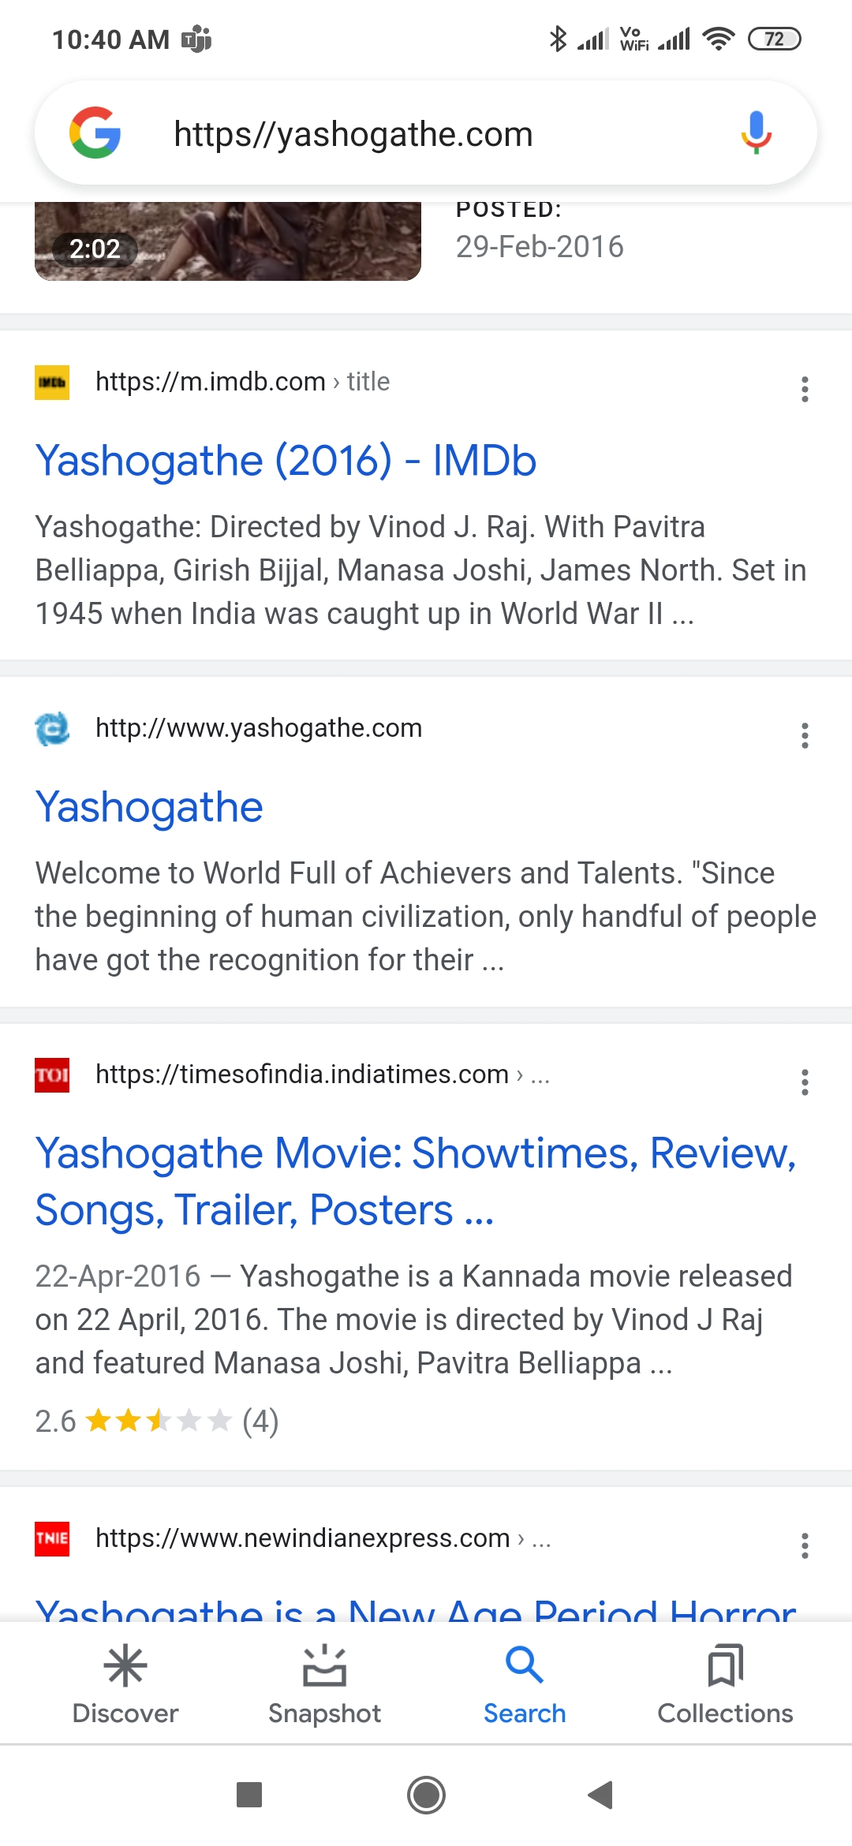
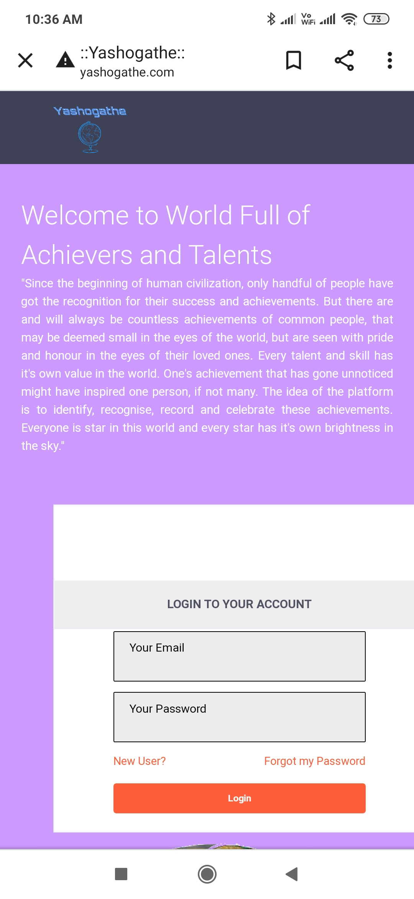
Mobile Version
“https//” is not coming during google search.
“Login” portal is not at the center of the mobile.
“Search and Support ” is NOT appearing in the Main Page

Slide 8
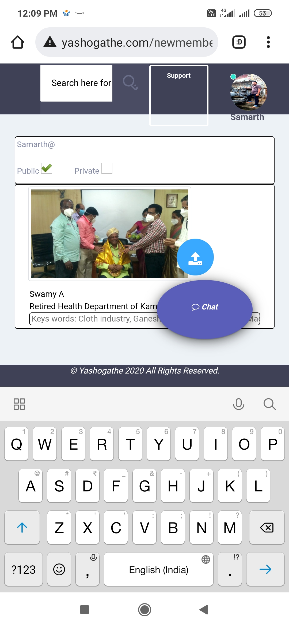
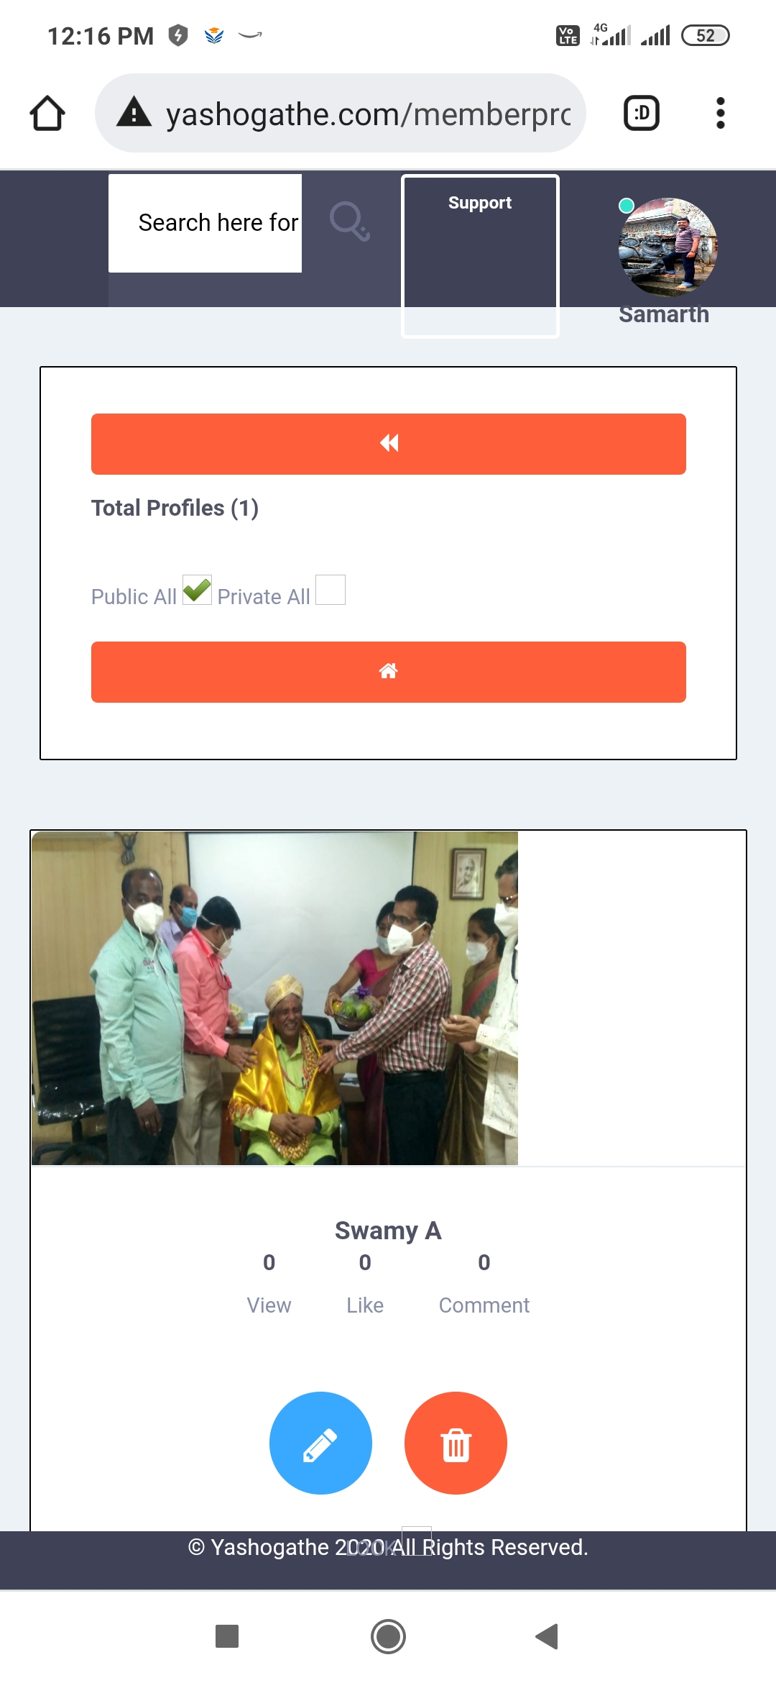
Mobile Version
“Chat” icon is coming above profile, so difficult to write.
Image is not at center.

